Slide 1

Shri Vaishnav Vidyapeeth Vishwavidyalaya,
Indore(M.P.)
Group No. 7
Presentation–II on
“Restaurant Recommendation System”
Presented by: Guided By:
Chahak Garg [20100BTCMCI07228] Mr. Alpesh Soni
Laiba Shaikh [20100BTCMCI07235]
Shashank Tiwari [20100BTCMCI07248]
Taha Cyclewala [20100BTCMCI07251]
Department of Computer Science and Engineering
Shri Vaishnav Institute of Information Technology, Indore (M.P.)
Notes:
Rajesh Kumar Chakrawarti

Slide 2
Introduction
A restaurant recommendation system is a technology-driven solution designed to assist individuals in finding dining establishments that align with their preferences, taste, and dietary requirements. These systems leverage various data sources and machine learning algorithms to suggest restaurants that are likely to provide a satisfying dining experience for the user. Whether you're a food enthusiast looking for new culinary experiences or a traveler seeking local dining options, a restaurant recommendation system can help you discover the perfect place to eat.

Slide 3
Problem Domain
In today's fast-paced and diverse culinary landscape, individuals often struggle to find the right restaurant that suits their preferences, resulting in decision fatigue and wasted time exploring numerous options.
Therefore, there is a need for an intelligent and efficient restaurant recommender system that can alleviate these challenges by providing personalized and accurate recommendations based on individual preferences, location, dietary restrictions, and other relevant factors.
The recommender system should address the following key problems:
Information Overload
Lack of Personalization
Discoverability
Trust and Reliability

Slide 4
Solution Domain
The purpose of a restaurant recommendation system is to help individuals or users discover dining
options that align with their preferences, tastes, and requirements. These systems use algorithms and
data analysis techniques to suggest restaurants based on various factors, including:
User Preferences: Recommendation systems consider a user's past dining experiences, ratings, reviews, and interactions with the platform to understand their preferences. This personalization helps users discover restaurants that are likely to appeal to them.
Location: Recommender systems often take into account the user's current location or a specified location to recommend restaurants that are nearby or within a certain distance.

Slide 5
Solution Domain
Cuisine and Food Type: Users can specify their preferred cuisine or type of food they're interested in (e.g., Italian, Mexican, vegetarian, seafood), and the system will suggest restaurants that serve those types of dishes.)
Budget: Users can set their budget preferences, allowing the system to recommend restaurants that match their price range, whether it's fine dining, casual dining, or budget-friendly options.

Slide 6
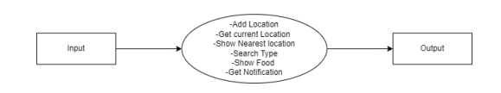
Conceptual Design
DFD level-0

Slide 7
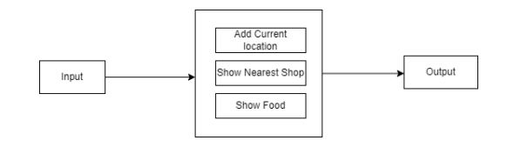
Conceptual Design
DFD level-1

Slide 8
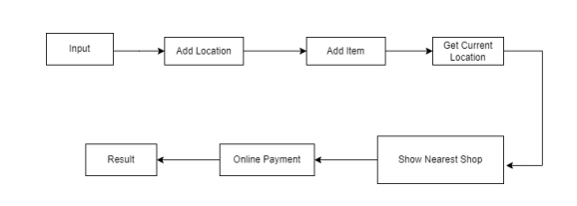
Conceptual Design
DFD level-2

Slide 9
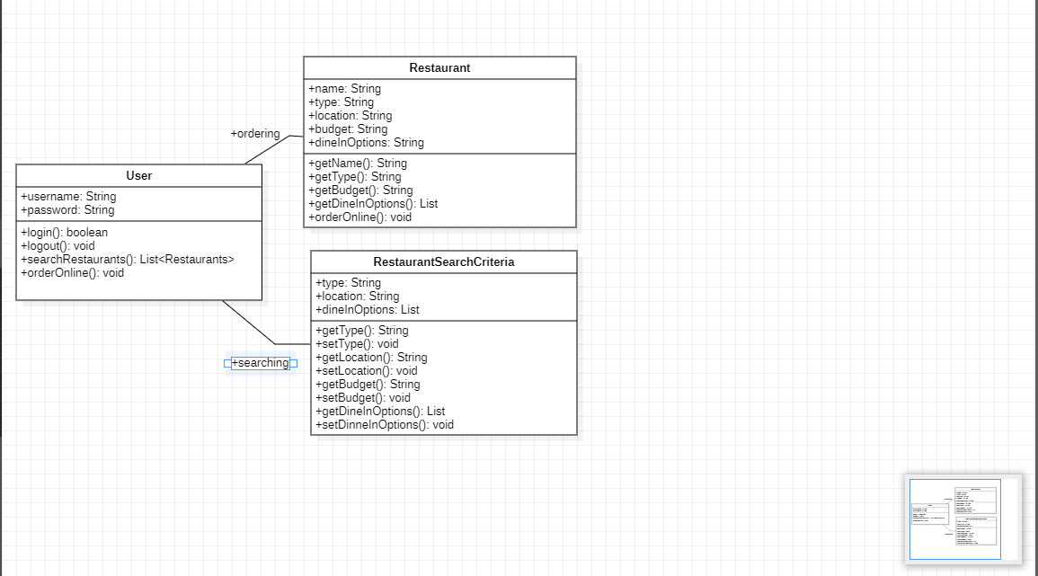
Conceptual Design
Class Diagram

Slide 10
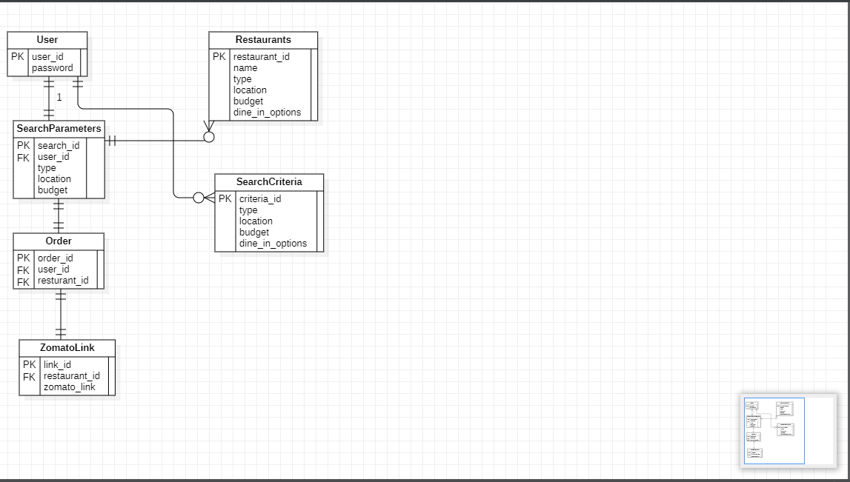
Conceptual Design
ER diagram

Slide 11
Thank You

